Slide 1
Resampling Methods
Resampling methods are an indispensable tool in modern statistics. They
involve repeatedly drawing samples from a training set and refitting a model
of interest on each sample in order to obtain additional information about
the fitted model.

Slide 2
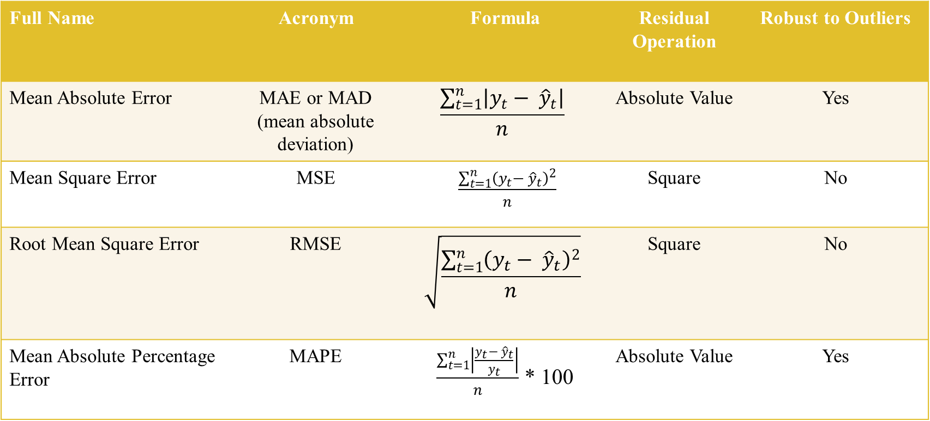
The Error Metrics
Full Name | Acronym | Formula | Residual Operation | Robust to Outliers
Mean Absolute Error | MAE or MAD (mean absolute deviation) | $$\frac{\sum_{t=1}^{n}{\left|y_{t}− {\hat{y}}_{t}\right|}}{n}$$ | Absolute Value | Yes
Mean Square Error | MSE | $\frac{\sum_{t=1}^{n}{{\left(y_{t}− {\hat{y}}_{t}\right)}^{2}}}{n}$ | Square | No
Root Mean Square Error | RMSE | $$\sqrt{\frac{\sum_{t=1}^{n}{{\left(y_{t}− {\hat{y}}_{t}\right)}^{2}}}{n}}$$ | Square | No
Mean Absolute Percentage Error | MAPE | $\frac{\sum_{t=1}^{n}{\left|\frac{y_{t}− {\hat{y}}_{t}}{y_{t}}\right|}}{n}$ * 100 | Absolute Value | Yes
Notes:
RMSE & MSE: sensitive towards far off outliers
MAPE vs MAD: a little less sensitive to outliers

Slide 3
Types of Resampling
Validation Set Approach
Cross Validation
Leave-One-Out Cross Validation (LOOCV)
K-Fold Cross Validation
The Bootstrap
These methods refit a model of interest to samples formed from the training set, in order to obtain additional information about the fitted model.
We use resampling when the training error is too optimistic, and in order to get a better idea of the test set error.

Slide 4
The Validation Set Approach
The first up is the validation approach, which consists of randomly splitting the data into two sets: a training set and the remaining other set is used to test the model (the validation set).
In the validation set approach, the testing set can be thought of as the validation set or the hold-out set.
The process works as follows:
Build a model using the training dataset.
Apply the model to the testing dataset to predict the outcome of unused observations.
Quantify the prediction error as the as the mean squared difference between the observed and the predicted outcome values.

Slide 5
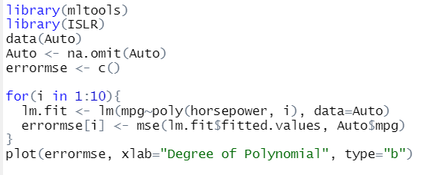
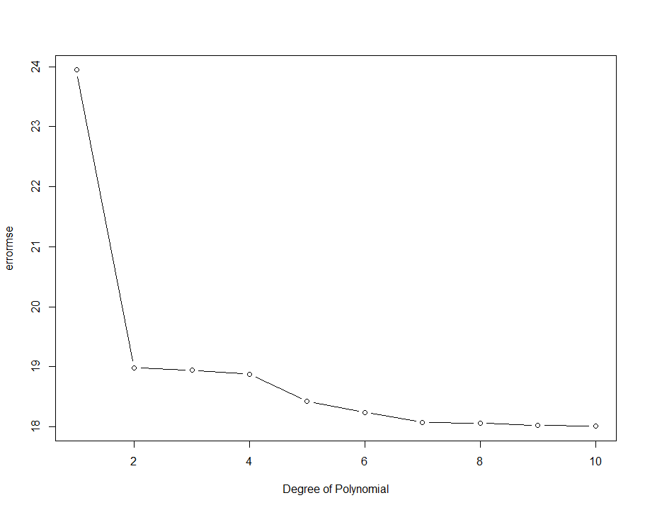
Usefulness of MSE in Selecting the Right Model
The validation set MSE for the quadratic fit is considerably smaller than for the linear fit.
•The validation set MSE for the cubic fit is actually about the same as the quadratic fit.
•This implies that including a cubic term in the regression does not lead to better prediction than simply using a quadratic term.

Slide 6
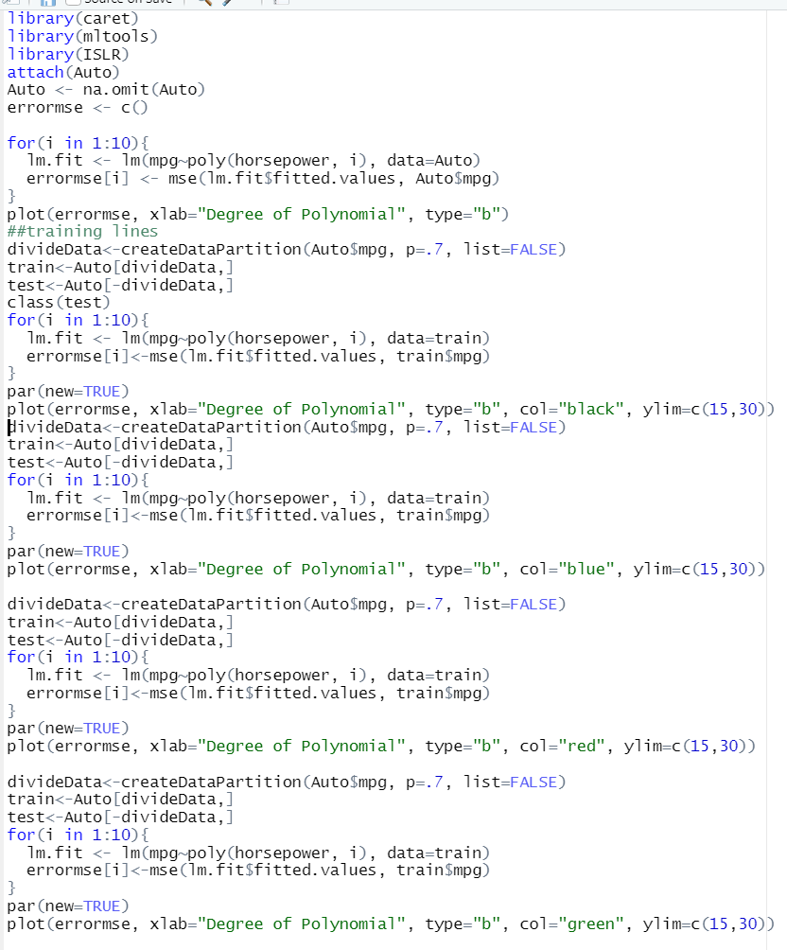
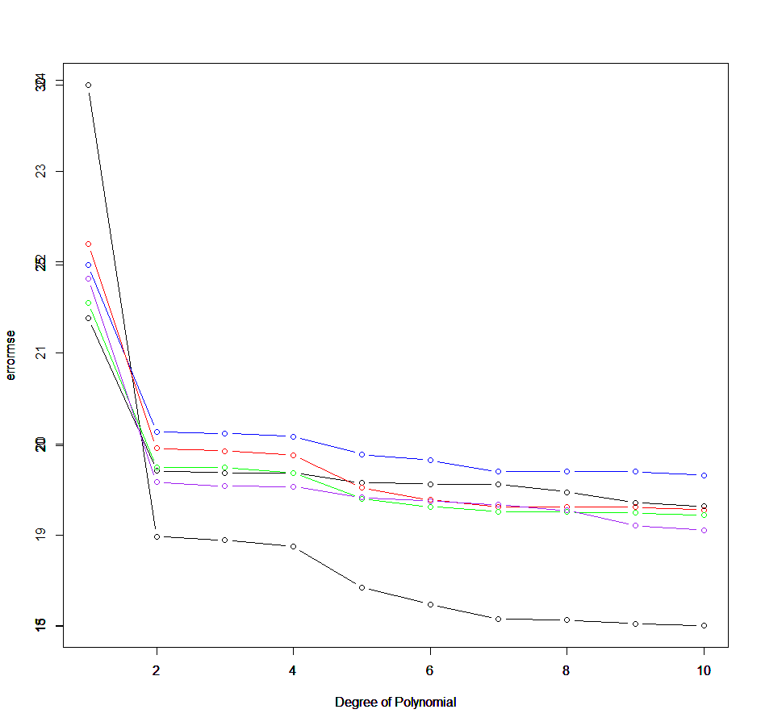
Looking at Validation
Let’s run that multiple times with different random training groups and see how the training MSE changes
Each of the curves results in a different training MSE estimate

Slide 7
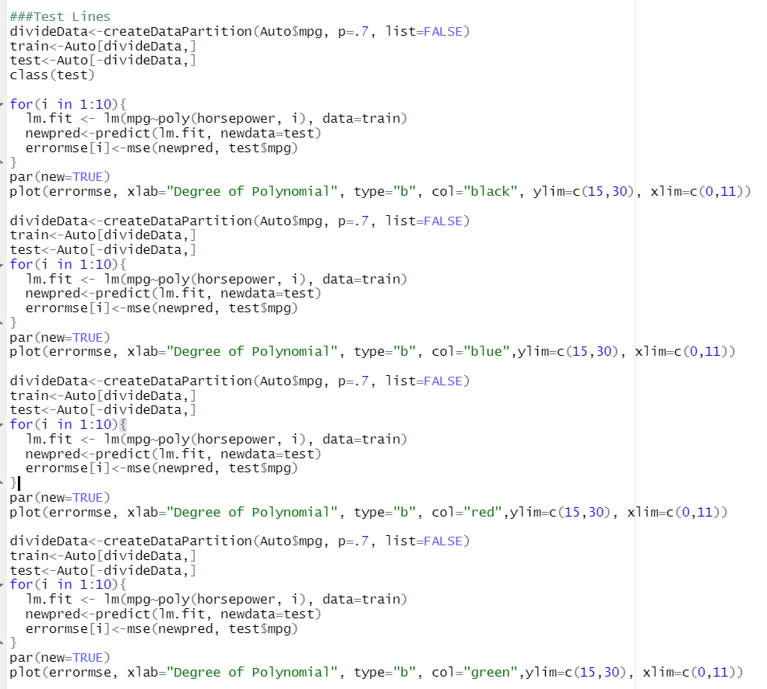
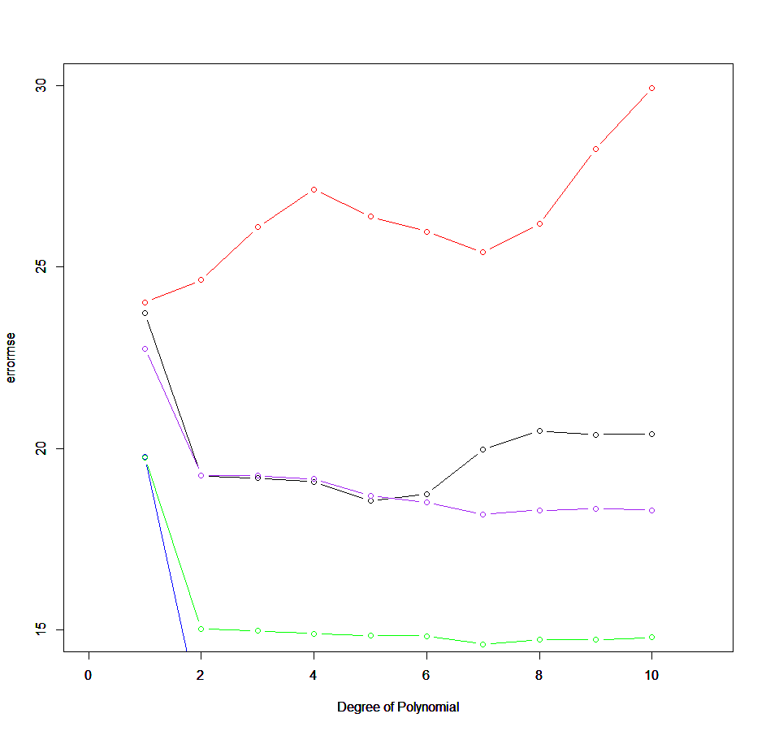
Looking at Validation
Let’s run that multiple times with different random training groups and see how the testing MSE changes
Each of the curves results in a different testing MSE estimate

Slide 8
Problems with Validation Set approach
While the validation set approach is conceptually simple and is easy to implement, it has two potential drawbacks:
The validation estimate of the test error rate can be highly variable, depending on precisely which observations are included in the training set and which observations are included in the validation set.
Only a subset of the observations are used to fit the model. Since statistical methods tend to perform worse when trained on fewer observations, this suggests that the validation set will introduce bias by systematically misestimating the test error rate for the model fit on the entire data set.
Cross-validation, a refinement of the validation set approach, addresses these two issues.

Slide 9
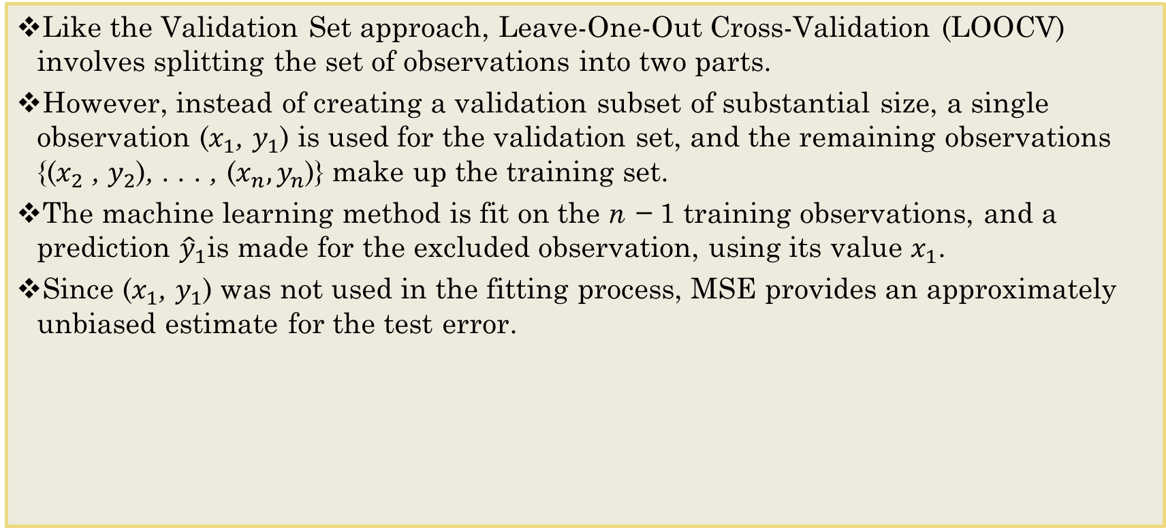
Leave One Out Cross Validation (LOOCV)
Like the Validation Set approach, Leave-One-Out Cross-Validation (LOOCV) involves splitting the set of observations into two parts.
However, instead of creating a validation subset of substantial size, a single observation ($x_{1}$, $y_{1}$) is used for the validation set, and the remaining observations {($x_{2}$ , $y_{2}$), . . . , ($x_{n}, y_{n}$)} make up the training set.
The machine learning method is fit on the n − 1 training observations, and a prediction ${\hat{y}}_{1}$is made for the excluded observation, using its value $x_{1}$.
Since ($x_{1}$, $y_{1}$) was not used in the fitting process, MSE provides an approximately unbiased estimate for the test error.

Slide 10
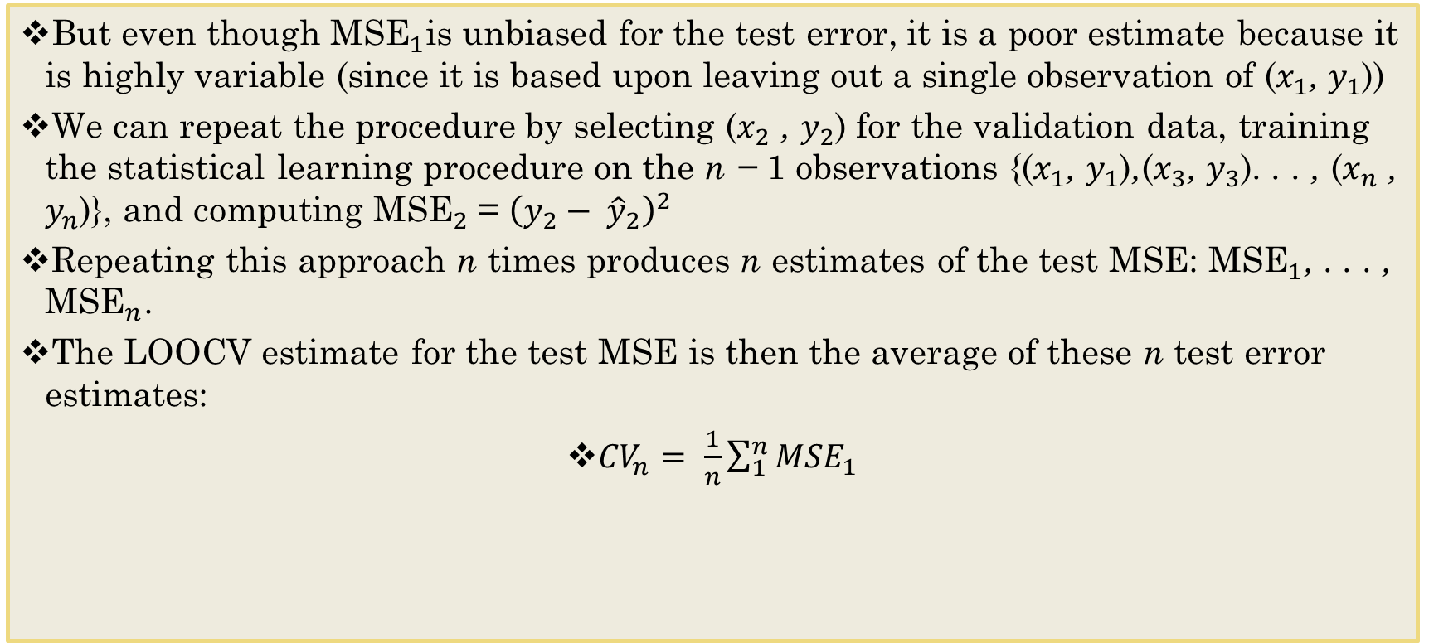
Error Metric for LOOCV
But even though ${\text{MSE}}_{1}$is unbiased for the test error, it is a poor estimate because it is highly variable (since it is based upon leaving out a single observation of ($x_{1}$, $y_{1}$))
We can repeat the procedure by selecting ($x_{2}$ , $y_{2}$) for the validation data, training the statistical learning procedure on the n − 1 observations {($x_{1}$, $y_{1}$),($x_{3}$, $y_{3}$). . . , ($x_{n}$ , $y_{n}$)}, and computing ${\text{MSE}}_{2}$= ${\left(y_{2}− {\hat{y}}_{2}\right)}^{2}$
Repeating this approach n times produces n estimates of the test MSE: ${\text{MSE}}_{1}$, . . . , ${\text{MSE}}_{n}$.
The LOOCV estimate for the test MSE is then the average of these n test error estimates:
${CV}_{n}= \frac{1}{n}\sum_{1}^{n}{{MSE}_{1}}$

Slide 11
Leave One Out Cross Validation (LOOCV)
Leave out one data point and build the model on the rest of the data set,
Test the model against the data point that is left out at step 1 and record the test error associated with the prediction,
Repeat the process for all data points, and
Compute the overall prediction error by taking the average of all these test error estimates recorded at step 2.
The advantage of the LOOCV method is that we make use all data points reducing potential bias.
However, the process is repeated as many times as there are data points, resulting to a higher execution time when n is extremely large.

Slide 12
Advantages of LOOCV
It has far less bias than the Validation Set.
In LOOCV, we repeatedly fit the statistical learning method using training sets that contain n − 1 observations, almost as many as are in the entire data set. Consequently, the LOOCV approach tends not to misestimate the test error rate as much as the validation set approach does.
Performing LOOCV multiple times will always yield the same results
There is no randomness in the training/validation set splits (in contrast, the validation approach yields different results when applied repeatedly due to randomness in the training/validation set splits).

Slide 13
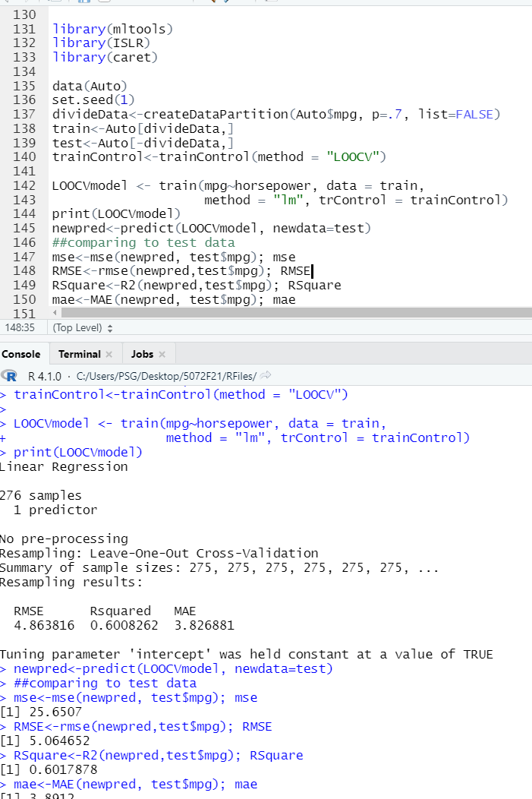
LOOCV Metrics
This technique can be very time consuming if n is large, and if each individual model is computationally intensive to fit.
See how the testing error metrics and R-square value compared to the training metrics provided

Slide 14
K-Fold
LOOCV is a special case of k-fold CV in which k is set to equal n.
In practice, one typically performs k-fold CV using k = 5 or k = 10 to reduce the computational burden (it is only necessary to fit the model an additional k times).
In addition to the computational advantage, k-fold CV also strikes a better bias-variance tradeoff.
LOOCV has very low bias (doesn't systematically underestimate MSE by a significant amount because it uses all but one of the observations) while bias for k-fold CV is relatively higher.
But k-fold CV has less variance than LOOCV since its models are significantly less correlated (and therefore have less variance) than LOOCV models.
In LOOCV, we are essentially fitting n almost-identical models, leading to high levels of correlation among the MSE estimates
In most cases, the intermediate level of bias and lower variance of k-fold CV identifies models with better predictive power.

Slide 15
K-Fold
The k-fold cross-validation method evaluates the model performance on different subset of the training data and then calculate the average prediction error rate.
The algorithm randomly splits the data set into k number of subsets (or k-fold)
We reserve one subset and train the model on all other subsets.
We test the model on the reserved subset and record the prediction error and repeat this process until each of the k subsets has served as the test set.
Finally, we compute the cross-validation error by taking the average of the k-errors serving as the performance metric for the model.
An important advantage of k-fold CV is that it should give more accurate estimates of the test error rate over LOOCV.

Slide 16
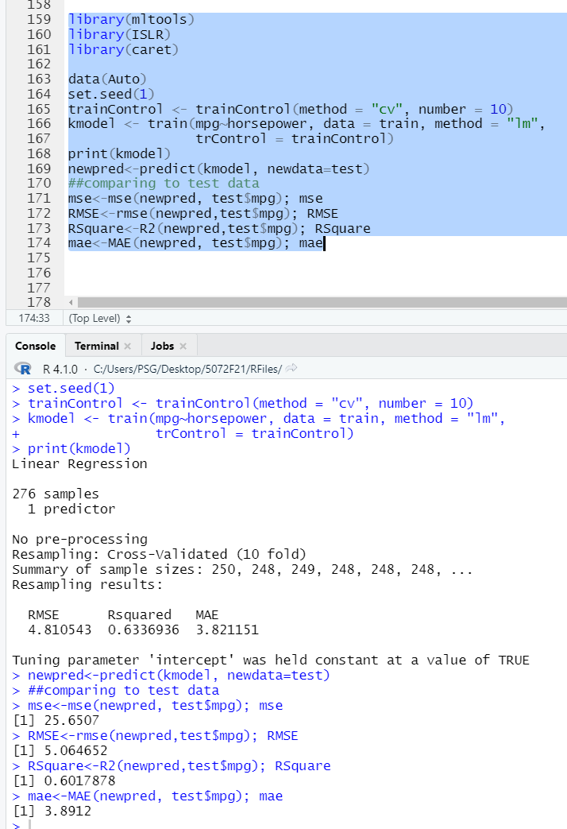
K-Fold Error Metrics and R^2 Comparison
Notes:
Number = 10 → k=10

Slide 17
K-Fold Cross-Validation
How accurate is the CV estimate? It's difficult to generalize to real-world problems since we don't know the true MSE’s.
We can use simulated data to gain some insight, however.
Blue: The true Test MSE
Black dashed: LOOCV estimate
Orange solid: 10-fold
In all three plots, the two cross-validation estimates are very similar.
In the right-hand panel, the true MSE and the CV curves are almost identical.
In the center panel, the two sets of curves are similar at the lower degrees of flexibility, while the CV curves overestimate the true MSE for higher degrees of flexibility.
In the left-hand panel, the CV curves have the correct general shape, but they underestimate the true MSE.

